Slide 1

Workforce Development Analysis: Salaries & Tuition Assistance in Montgomery County
Final Report | Dajana Ramirez Andrade | DATA 205 | CRN: 33334

Slide 2



Goals & Methods
Three Key Questions:
Are there statistically significant gender pay gaps?
How is tuition assistance distributed?
Is there a salary-tuition relationship?
Tools:
R for analysis
Tableau for interactive dashboards
OpenRefine for data cleaning

Slide 3


Data Overview
Sources:
Employee Salaries(2024): 10,400 rows, 8 cols
Tuition Assistance (Updated Feb 2025): 4,539 rows, 7 cols
Key Cleaning Steps:
Standardized 25 department names in Employee Salaries ("Police Dept" → "Police") (OpenRefine)
Filtered for shared departments between Employee Salaries & Tuition Assistance
Handled missing grades (salaries) and course descriptions (excluded)

Slide 4



EXPLORATORY DATA ANALYSIS
Insight 1: Top 3 Departments by Funding
Police ($1,179,935) 2. Fire/Rescue ($716,914) 3. Health & Human Services ($634,261)
Insight 2: Most Funded Degrees
Bachelor’s – Count: 1,442 | Cost: $1,049,634
Master's – Count: 945 | Cost: $1,085,831
Associates – Count: 680 | Cost: $293,026
Insight 3: Cost Distribution By Majors
None Majors
Business/Admin./Mgmt.
Criminal Justice
://public.tableau.com/views/TuitionAssistanceAnalysisDashboard/Dashboard1?:language=en-US&:sid=&:redirect=auth&:display_count=n&:origin=viz_share_link

Slide 5



EXPLORATORY DATA ANALYSIS
Insight 1: Top 3 Paid Departments
1. Legislative Oversight ($149,888) (no overtime) 2. Management & Budget ($148,985) (no overtime) 3. Technology Services ($138,580) ($456 overtime)
Insight 2: Highest Overtime
Correction & Rehabilitation | Overtime $: 24,259
Board of Elections | Overtime $: 21,235
Fire/Rescue Services | Overtime $: 21,213
Insight 3: Salary by Gender & Department
Legislative Oversight | Female Base Salary: $139,196 | Male Base Salary: $184,640
County Executive | Female Base Salary: $122,962 | Male Base Salary: $170,888
Police | Female Base Salary: $78,357 | Male Base Salary: $105,166
https://public.tableau.com/views/SalaryDataAnalysisDashboard/Dashboard1?:language=en-US&:sid=&:redirect=auth&:display_count=n&:origin=viz_share_link

Slide 6



Police Pay Gap Findings
Key Results:
Male:$105,166 vs Female:$78,357
$26,809 mean difference (p < 0.001) (t = -14.70) (34.2% higher for males)
Cohen's d = 0.79 (Large effect)
Female officers earn 74.5% of male salaries (0.745 per 1)
Impact:
Requires 2-3 promotions at 10% salary increase to match male pay
$536k lifetime earnings gap (20 years)
Final:
The difference is both statistically and practically significant

Slide 7
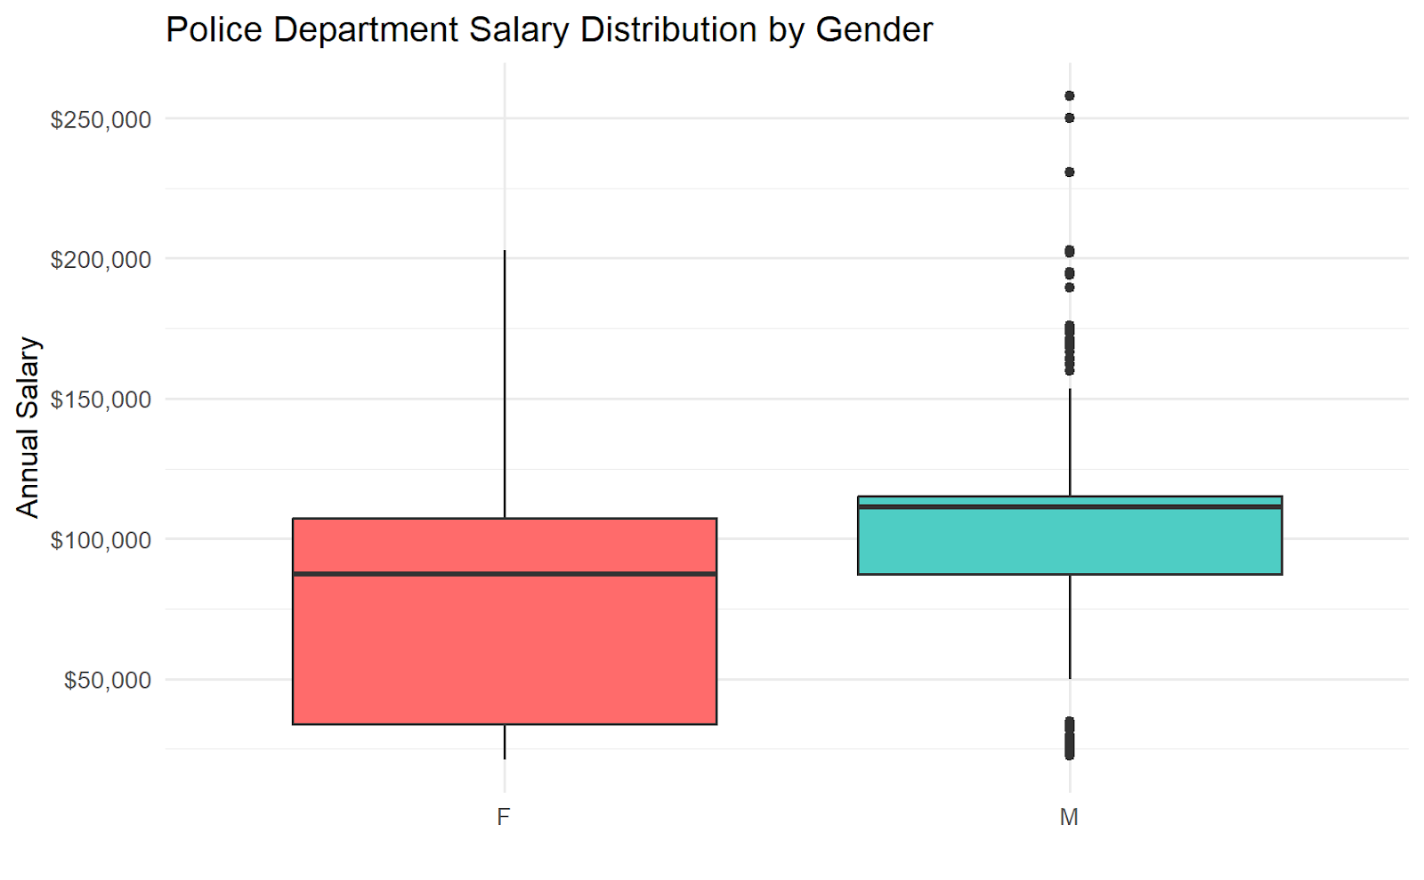
Visualization of Police Gender Pay gap

Slide 8



Legislative Oversight Pay Gap Findings
Key Results:
Male:$184,640 vs Female:$139,196
$45,444 mean difference (p < .067) (t = - 2.29) (32.6% higher for males)
Cohen's d = 1.37 (very large effect size)
Female officers earn 75.4% of male salaries (0.754 per 1)
Impact:
Requires 3 promotions at 10% salary increase to match male pay
$909k lifetime earnings gap (20 years)
Next:
Large point estimate but limited by a small sample.
I’ll run a power test

Slide 9
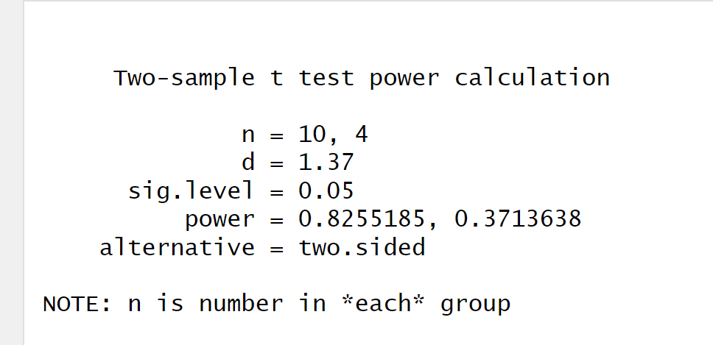
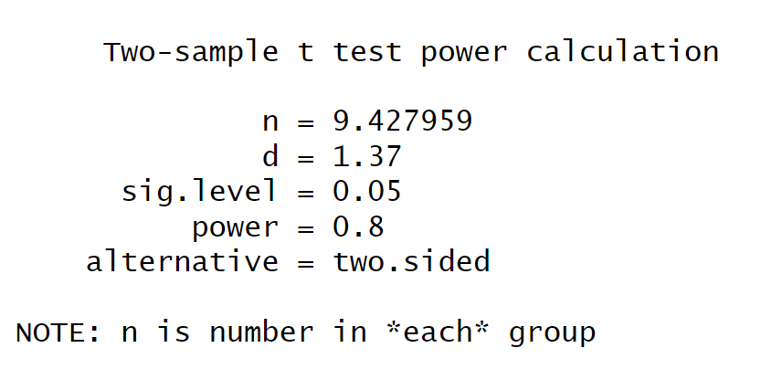
Power Test
Key Finding: 63% power to detect the $45k gender pay gap
Statistical Details:
Current sample: 10 Female vs 4 Male employees
Effect size (Cohen's d): 1.37 (Very Large)
p-value: 0.067 (approaching significance)
What This Means:
Type II Error Risk (False Negative): chance of missing a real effect
Need +6 male records for 80% confidence

Slide 10
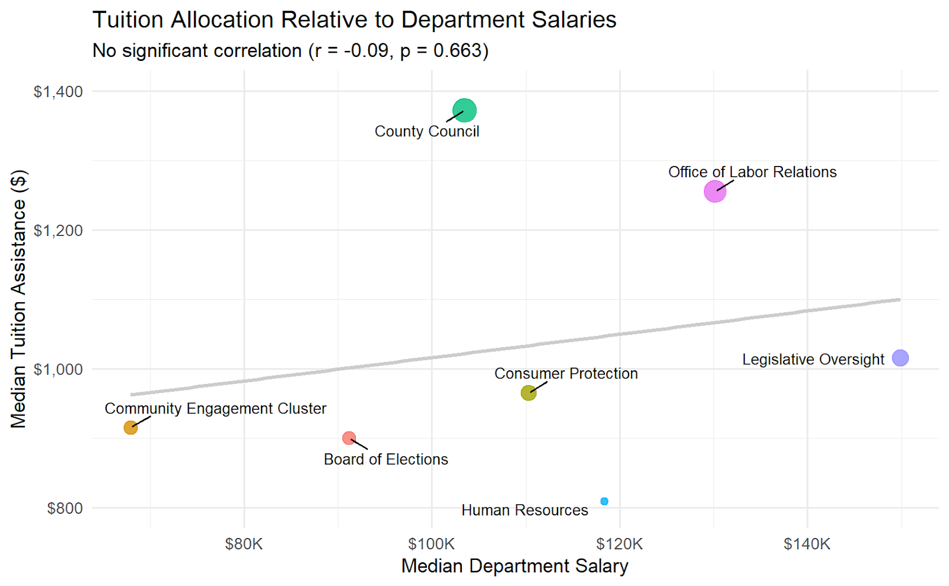
Tuition & Salary Relationship
No Systemic Relationship
Weak, non-significant correlation (r = -0.09)
Departments at all salary levels have access to tuition funds
Notable Outliers
Community Engagement Cluster:
Lowest-paid ($67,893)
Legislative Oversight:
Highest-paid ($149,888)
Interpretation: The tuition program demonstrates equitable access.

Slide 11
Conclusion
Key Findings:
1. ✔ Confirmed Police Pay Gap:
• $26,809 disparity (p < 0.001)
• Females earn 75.4% of male salaries
⚠ Legislative Oversight Concerns:
• $45,444 gap needing verification • Currently underpowered (63%)
3. ✔ Tuition Program Success:
• No salary-based bias (r = -0.09)

Slide 12
NEXT STEPS
Immediate Priorities (0-6 Months):
Police Department Salary Review
Comprehensive audit controlling for:
Rank
Years of service
Overtime hours
Success targets:
Reduce effect size: d = 0.79 → <0.5
Narrow 95% CI to ± $5,000
2. Legislative Oversight Data Collection
Required : 6+ male records
Goal: Achieve 80% statistical power
Will Validate:
Current 75.4% female-to-male earnings ratio
$45,444 observed gap
Long-Term Solutions (12+ Months)
Automated Equity Dashboard
Real-time monitoring of
Pay gap metrics
Tuition Participation
Promotion Pipelines
2. Longitudinal Study
Track tuition recipients' career progression
Control for education/experience
Current limitations:
Cannot account for education/experience
Legislative sample underpowered (63%)
Single-year snapshot

Slide 13
Acknowledgements
Professor Perine – Helped me navigate my dataset and guidelines in the project

Slide 14
Thank you for listening! Questions?

